Slide 1

Ralph Nelson Ravesh Lala Swami Chandrasekeran Cristene Gonzalez-Wertz July 8th, 2016 Cognitive Solutions 2H July Enablement
Watson Sales Accelerators

Slide 2

Sales Acceleration through . . .
Science
Simplicity
Scale
Leverage strong Platform & WEX capabilities
Show immediate Business value
Board Watson & grow
Demonstrate the capability up front
Provide materials & tools to quickly sell the value
Sales bundles that are easier for clients to consume
More capabilities made available every 2 weeks
Faster qualification with broader range of prospects
Regular drumbeat of new clients on Watson
2
Cognitive Solutions July 2016 Enablement

Slide 3
Our approach
Strategic Intent
What is different
What to expect
Pilot a frictionless sales execution model to onboard clients to the Watson Platform and Hybrid Cloud (WEX)
Reduce mean time to SaaS to weeks from months and years
Make it easy for larger IBM sales force to sell Watson
These are examples of client business problems that we can solve using Watson
These examples transcend multiple industries
The goal is to start educating the sales team on these types of solution patterns and arm sales team with real demos
We are going to talk about 5 solution patterns today
In 2 weeks we will review the next 2 and thereafter get on a 2 week running schedule with more solution patterns
There is a dedicated pre sales team to help you with client specific demos and any help you need
3
Cognitive Solutions July 2016 Enablement

Slide 4
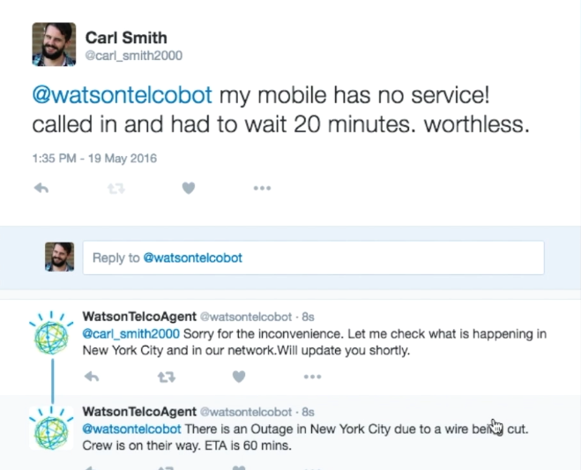
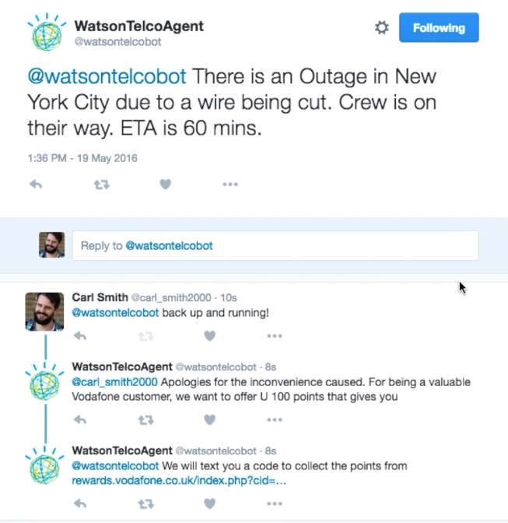
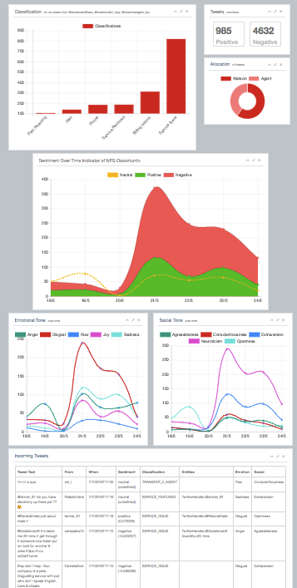
1. Leveraging API’s w/ Twitter to engage customers
Watson as the IVR for the digital universe
Ability to respond to requests in real time
Triage customer complaints and route them to the right organizations
Analyze conversations and tweets in real time
4

Slide 5
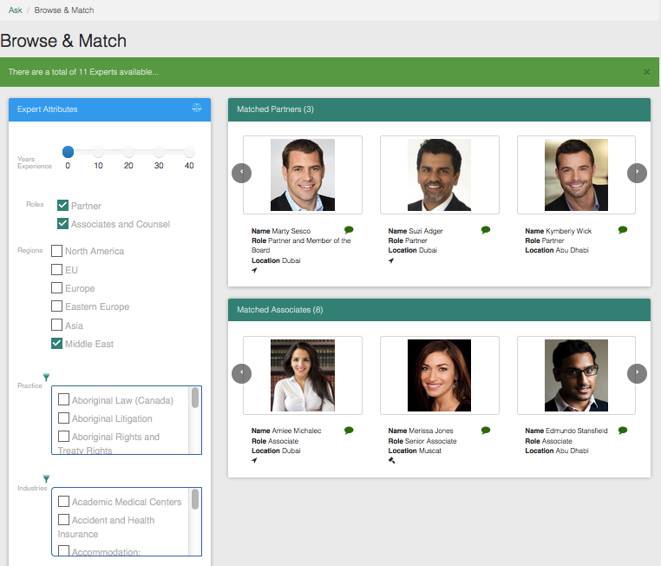
2. Leveraging WEX to locate expertise
Match expertise with relevant employee experience
Streamline a company’s internal discovery process for resource matching to projects
This pattern can be applied to any scenario where locating human expertise globally is essential to solving problems
5

Slide 6
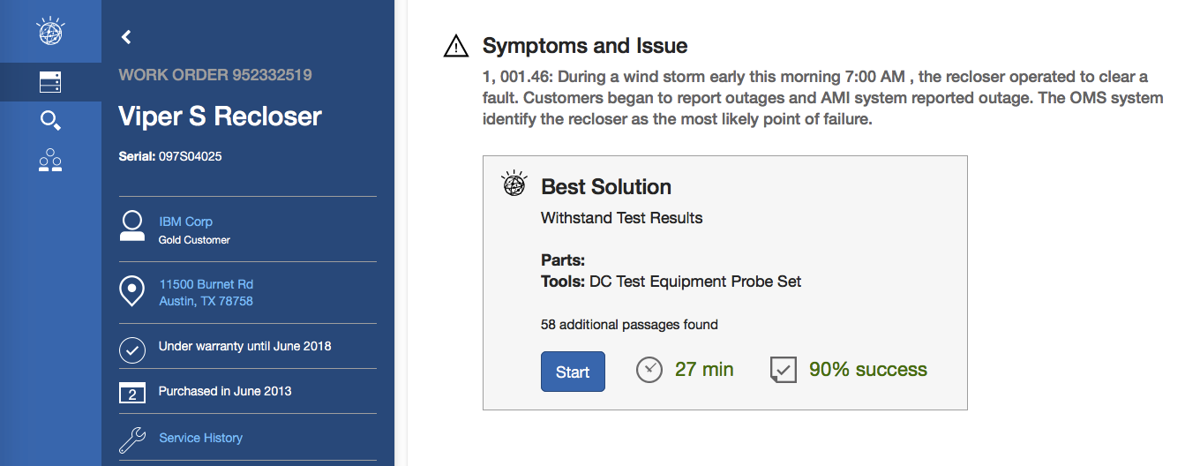
3. Leveraging WEX to assist ‘Repair Technician’
Allow a technician to tackle service request execution more efficiently over a simple interface
Deliver tools for diagnosis, context and repair; connecting to current internal systems
Enable technicians to fix problems the first time, reduce service write-offs, drive incremental revenue, and improve customer satisfaction overall
6

Slide 7
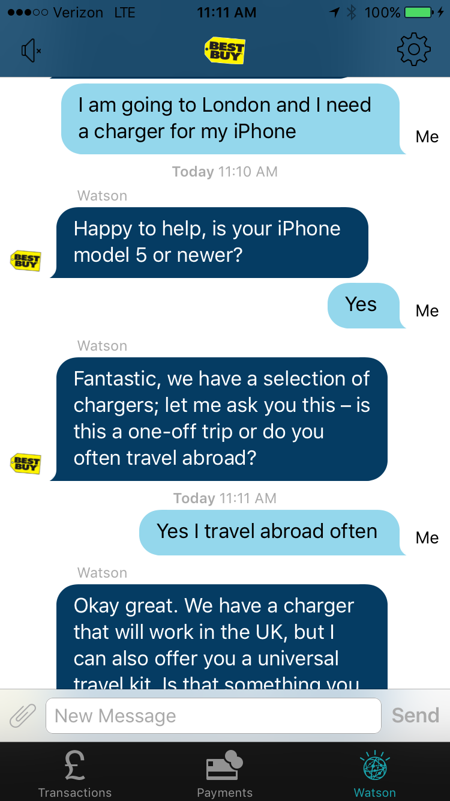
4. Building a conversation bot with Watson
Demonstrate how large enterprises can engage with their customers via self service
Answer inquiries or triage them to the right agents within the enterprise
Can be integrated this into their existing iOS/Android customer facing apps – a real benefit according to several CEO who have seen it
** Special thanks to Duncan Anderson and Chris Williams from the Europe team for building this asset
7

Slide 8
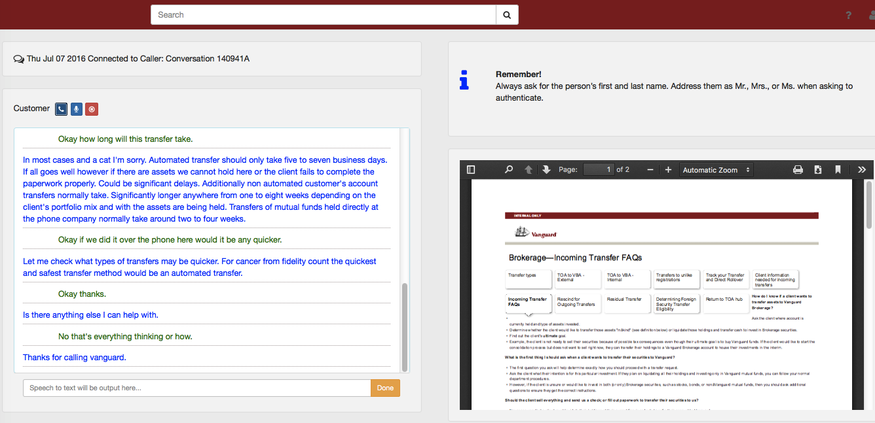
5. Leveraging speech to text for Agents
Listen into the conversation between the customer and agent, understand the intent of customer's and surface relevant information and actions for the agent
Enable agents to ask Watson for specific help when needed
8

Slide 9
Live Demos
9

Slide 10
Give your sales an accelerated start in the second half.
We are launching new patterns and prototypes continuously this year.
Group One Assets:
Click to go to Box folder
Today
By August
By Year End
Download the 5 launched accelerators
(Link)
Solution Card
Seller Deck
Demo
Script
Video (coming soon)
Support through humans: Owen Coelho or Cristene Gonzalez-Wertz for this month
Enriched sales materials:
Client Ready Materials
Pricing Models
Five more solutions
Improved ways for you to request customized demos and new ideas
Support through Slack Channels
50-60 Patterns
100’s of prototypes
Deeper and better digital sales kits
Benchmarks, success stories and case studies
Streamlined, simple processes
10

Slide 11
What comes next?
Five more solutions, coming in the next 4 weeks
 | Use Case | WEX | APIs | Analytics | Target Enablement
1 | Agent Assist | X | X | X | July 8th, 2016
2 | Social CRM BOT |  | X | X | July 8th, 2016
3 | Expertise Finder | X | X |  | July 8th, 2016
4 | Equipment Repair and Maintenance | X | X | X | July 8th, 2016
5 | Conversational BOT |  | X |  | July 8th, 2016
6 | Contact Center Analytics | X | X | X | July 22nd, 2016
7 | Cognitive Claims | X | X | X | July 22nd, 2016
8 | Brexit | X | X |  | August 5th, 2016
9 | Network Optimization | X | X | X | August 5th, 2016
10 | KYC – Know Your Customer | X | X |  | August 12th, 2016
Watson APIs used
Conversation
NLC & Dialog
R&R
WKS with SIRE
AlchemyLanguage
AlchemyData News
Document Conversion
Tone Analyzer
AlchemyData Buckets or Future Knowledge Graph
Personality Insights
11

Slide 12
WEX Fast Start Bundle
A simple bundle to board the client on the Watson Hybrid Cloud
Overview | Bundle of WEX AE, WDC and WKS
Goal | Create a low barrier of entry for new customers with limited entitlement of WEX technology bundled with cloud services
Entitlements | 1 RVU WEX AE perpetual license 6 month free subscription to WKS to provide tooling to expand annotators 6 month free subscription to WDC to get the client started on the Watson Cloud
Pricing | All-in price of $250K Accounting treatment - $200K Transactional Revenue + $50K SaaS ACV
GTM Approach | Coordinated Marketing lead campaign focused on Hybrid Cloud value Sales Kit unique to each use case pattern (includes elevator pitch & value prop) Live Prototype to demonstrate capability for multiple use cases Board client quickly. Drive follow-on SaaS and RVU growth sales.
12

Slide 13



Watson Platform Service Offerings Offerings Overview
Cost
15-20K (to be approved)
Design Workshop
Architecture Workshop
Hackathon
Intent
Enable client to develop a deep understanding of Watson Developer Cloud capabilities, and create a high level systematic plan to build and deploy the solution
Agenda
3 day experience with Watson Architects where client gets hands-on with Watson Solutions
Outcome
Validated use case and solution architecture that aligns with WDC capabilities
Design content, training, and integration strategy
Cost
35-40K (to be approved)
Intent
Leverage design thinking to identify solutions that deliver exceptional user experiences
Agenda
2 day session where clients work side-by-side with Watson Designers and Architects to solidify a use case journey
Outcome
Map client’s business strategy to a validated cognitive use case
Cost
15-20K (to be approved)
Intent
Enable client to develop rapid prototypes using Watson technology
Agenda
2 day IBM led workshop with a
pre-education component
Outcome
Enable creation of meaningful prototypes
Hands on experience with the APIs
Validate technology
Cost
15-20K (to be approved)

Slide 14
Insert Q&A graphic chart
Questions?
Go Now:
Group One Assets:
Click to go to Box folder

